Slide 1
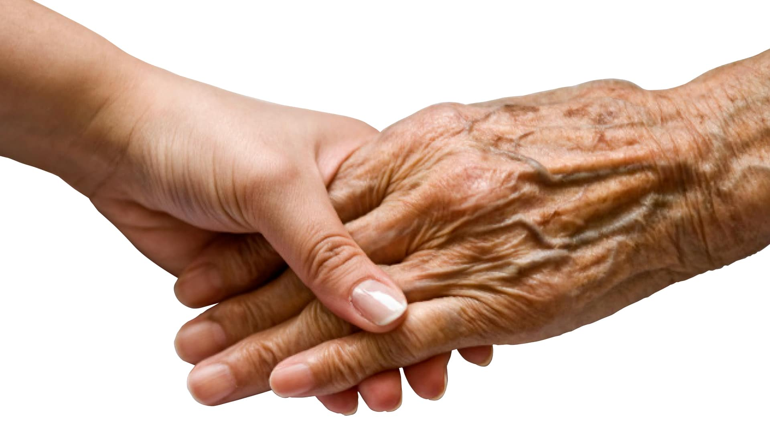
Priests Retirement Planning Seminar Diocese of Erie November 12, 2020 Dr. Gerry Tobin
Growing Old
(It beats the alternative!)
Psychological and Spiritual Aspects of Retirement

Slide 2
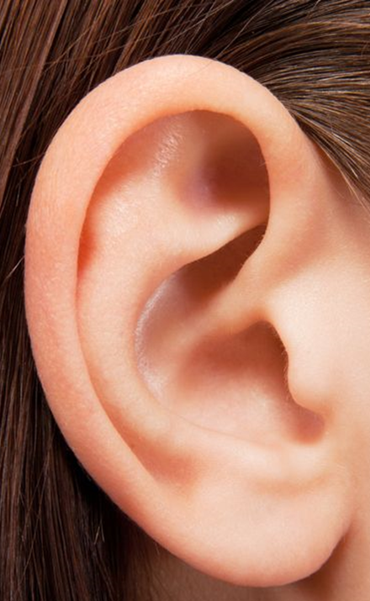
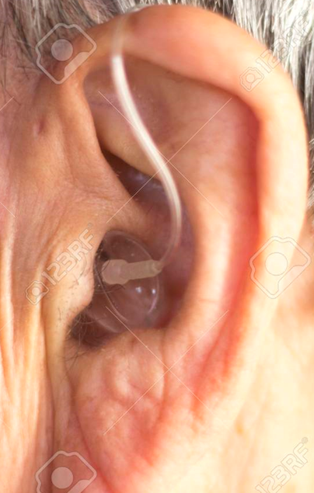
“Blest are your ears because they hear.” Mt.13:16

Slide 3
What is old?
Currently, 60,000 centenarians in the U.S.
By 2050, there may be at least 800,000 American centenarians!
Chronologically:
Young old age: 60-75
Old old age (75-85)
Oldest old age(>85) – fastest growing segment of the population!
Your chronological age is the number of years you’ve alive
Your biological age is how old your body seems, but, no worry…

Slide 4
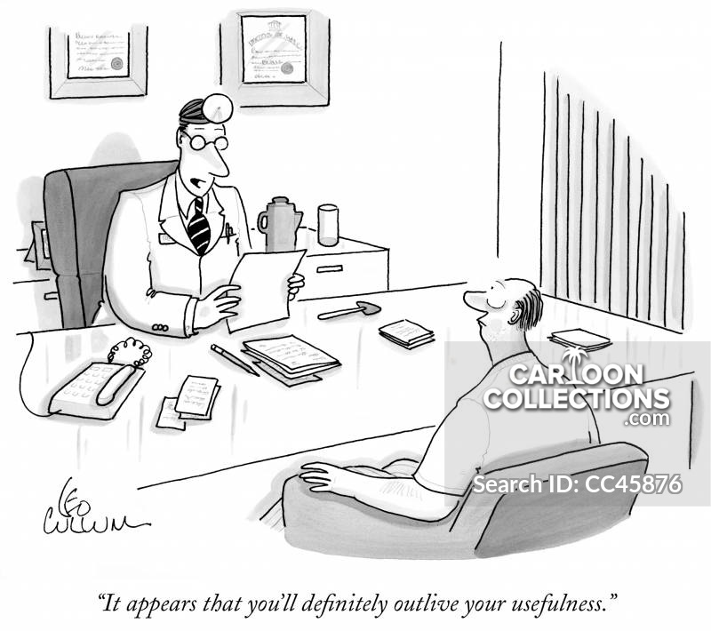
BUT

Slide 5
Health
Health is the single largest factor affecting physical and mental states over time!
Most older adults rate their health as good
Despite any experiences with disease and disability, elders are mostly emotionally quite resilient
Loss of balance associated with higher risks of falling (Tai Chi, golf)

Slide 6
Aging increases the risk of death!
In the Western culture, old age is seen as a disease.
We experience gradual bodily decline –
we don’t have the same energy – everything takes a little longer
loss of visual acuity
loss of hearing acuity,
our memory for words and names (and what was I looking for?) begins to fail us

Slide 7
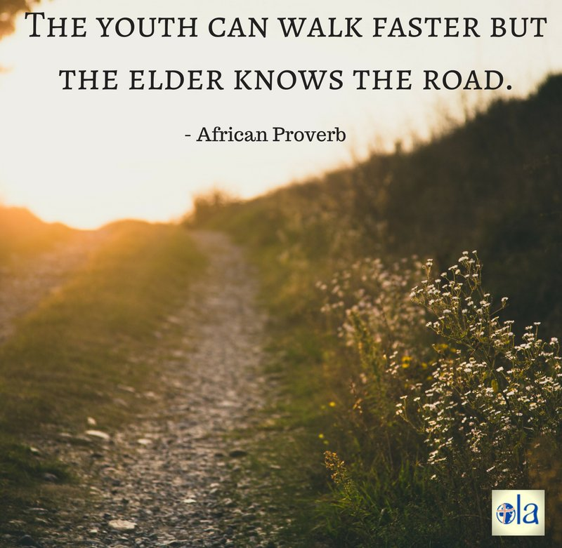
Every coin has two sides

Slide 8
The other side of the coin
How might aging be a gift of joy, wonder, compassion, and hope?
Decline in energy gives us an opportunity to pause, to stop doing and allow our selves to be (this may or may not be welcome!)
The loss of vision gives us an opportunity to look within, to visit and revisit the places of meaning in our lives – there is always something to learn
The loss of hearing provides the opportunity for us to listen to God’s voice within. “This is my beloved son in whom I am well pleased.”
Our decline in memory for things in the moment allows us to notice what we do remember – joys, successes, disappointments, losses

Slide 9
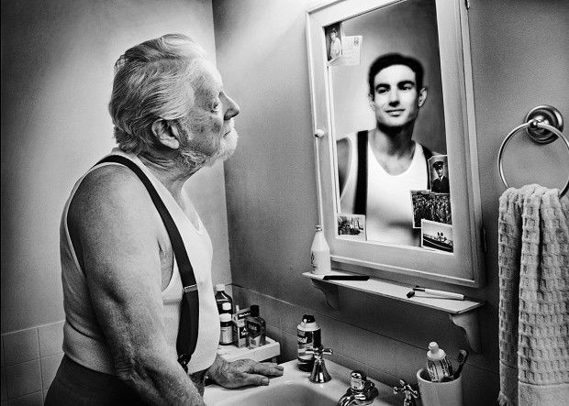
When did I get old?

Slide 10
Four phases of second-half of life development G. Cohen, MD, PhD
Ages 30 40 50 60 70 80 90 100+
I. Midlife reevalaution - QUEST
Quest rather than crisis – what do we want to do with our lives?
Less impulsive, more thoughtful, stronger sense of our self, mortality.
II. Liberation – ZEST
If not now, when? greater freedom to speak
one’s mind – what can they do to me?
III. Summing up – Meaning
Desire to share wisdom, your story,
find meaning. Keepers of the culture.
IV. Encore - Mellowing

Slide 11
Know Thyself
“Knowing others is intelligence, knowing yourself is true wisdom.”
Lao Tzu
Richard Rohr, Falling Upward
The first half of our lives is spent doing, influencing, establishing an identity, being who we think we are supposed to be (the Quest).
Aquinas looked back at all he accomplished and declared it was all straw!
The second half of life (Zest, Meaning, and Mellowing) invites us to let go, to simply be (which for action oriented people is not so simple) - sometimes it is age, illness, age and illness, failure, declining memory that invite us, perhaps unbidden, to know and experience ourselves as profoundly loved.
Augustine said, “God is more intimate to me than I am to myself.”

Slide 12
What you can do for yourself
Genes account for 25% of longevity; the other 75% is lifestyle choices.
Therefore, you have influence over your health!
Cognitive and physical loss is reduced by early intervention.
Exercise. - the most crucial variable that predicts longevity.
Watch your diet.
Remain active in ministry as best you can.
Keep learning. Stay curious.
Maintain friendships. Avoid isolation.
Pray and meditate – alone and with others.

Slide 13
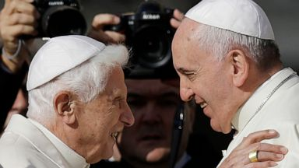
Some good news!
Generally, Catholic priests, monks, religious women and brothers live longer, healthier, more active lives with less pain, anxiety, and depression than their peers in the general population.

Slide 14
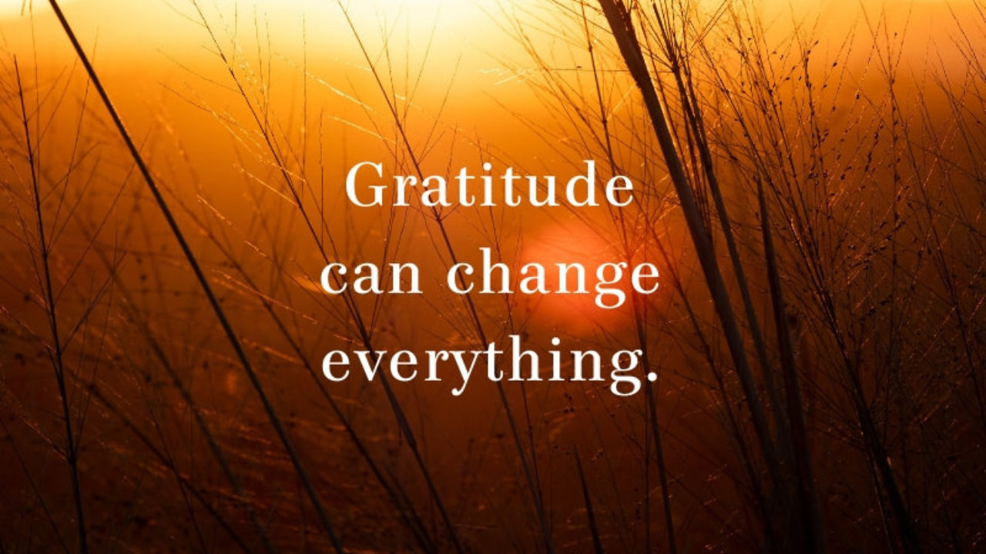
Gratitude→Happiness→Holiness
Holiness comes wrapped in the ordinary.
Happiness does not bring gratitude, rather gratitude for the ordinary results in happiness and brings us to holiness
Aging is humbling (sometimes humiliating) –

Slide 15
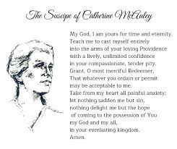

Slide 16
One Last Wish…
George Carlin “On Aging”
Thank you

